Slide 1

Artificial Intelligence Lecture 01: Background of AI
Farhad Muhammad Riaz

Slide 2
Lecture Outline
Personal
Administrivia
Basic Set Concepts of AI

Slide 3
Personel
Instructor:
Farhad Muhammad Riaz
Office hours: after class + Drop in when you’re around + Appointments
Research Area:
Deep Learning/ Machine Learning
Subject Area:
Design and Analysis of Algorithms, Automata Theory, Compiler Construction, Database Systems, Parallel and Distributed Systems, Discrete Structure, Digital Image Processing, ML,AI

Slide 4
Administrivia
Class Time Table
Tuesday: 4:35 – 05:50
Tuesday: 5:55 – 07:10
Venue: Room # 09 – Ghazali Block

Slide 5
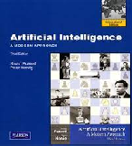
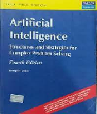
Course Textbooks
Primary Book:
Artificial Intelligence: A Modern Approach (AIMA)
Authors: Stuart Russell and Peter Norvig (3rd Ed.)
Reference Book:
Artificial Intelligence (Fourth Edition) by George F Luger

Slide 6
Course Objectives
Provide a concrete grasp of the fundamentals of various techniques and branches that currently constitute the field of Artificial Intelligence, e.g.,
Agents
Search
Knowledge Representation
Autonomous planning
Reasoning under uncertainty

Slide 7
Outline
Course overview
What is AI?
A brief history of AI
The state of the art of AI

Slide 8
Course overview
Introduction and Agents (Chapters 1,2)
Search (Chapters 3,4,5,6)
Logic (Chapters 7,8,9)
Planning (Chapters 11,12)
Reasoning under uncertainty ()

Slide 9
What is Intelligence?
The dream of AI has been to build. . . “. . . machines that can think, that learn and that create.”
“The quesNon of whether Machines Can Think. . . . . . is about as relevant as the quesNon whether Submarines Can Swim.”
Dijkstra (1984)

Slide 10
Strong and Weak AI
One may dream about. . . . . . that computers can be made to think on a level at least equal to humans, that they can be conscious and experience emoNons.
Strong AI
This course is about. . . . . . adding “thinking-like” features to computers to make them more useful tools. That is, “not obviously machine like”.
Weak AI

Slide 11
Weak AI
Weak AI is a category that is flexible, as soon as we understand how an AI-program works, it appears less “intelligent”.
And as soon as a part of AI is successful, it becomes an own research area! E.g. large parts of advanced search, parts of language understanding, parts of machine learning and probabilisNc learning etc.
And AI is lej with the remaining hard-to-solve problems!

Slide 12
What is AI?
Views of AI fall into four categories:
Systems that act like humans
Systems that think like humans
Systems that act rationally
Systems that think rationally
In this course, we are going to focus on systems that act rationally, i.e., the creation, design and implementation of rational agents.

Slide 13
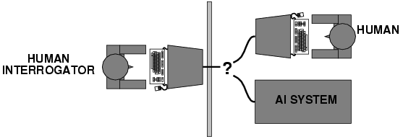
Acting Humanly: Turing Test
Turing (1950) ”Computing machinery and intelligence”.
A computer passes the test if a human interrogator, after posing some written questions, cannot tell whether the written responses come from a person or from a computer.
Anticipated all major arguments against AI in following 50 years
Little effort by AI researchers to pass the Turing Test

Slide 14
Turing Test
Major Components of Turing Test:
Natural Language Processing: To enable it to communicate successfully in English.
Knowledge Representation: To store what it knows or hears.
Automated Reasoning: To use the stored information to answer questions and to draw conclusions.
Machine Learning: To adapt to new circumstances and to detect and extrapolate patterns.
Total Turing Test also includes:
Computer Vision: To perceive objects
Robotics: To manipulate objects and move about

Slide 15
Thinking Humanly: Cognition
Expressing the Theory of Mind as a Computer Program
GPS (Newell & Simon 1961) does not only need to solve the problems but should also follow human thought process
Requires scientific theories of internal activities of the brain.
Cognitive Science: Predicting and testing behavior of human subjects
Cognitive Neuroscience: Direct identification from neurological data

Slide 16
Thinking Rationally: “Laws of Thought"
Aristotle: First to codify “right thinking”
Several Greek schools developed various forms of logic:
Notation and rules of derivation for thoughts
By 1965, programs existed that could, in principle, solve any solvable problem described in logical notation.
Problems:
Not easy to state informal knowledge in logical notation
Big difference between solving a problem "in principle" and solving it “in practice”
Problems with just a few hundred facts can exhaust the computational resources of any computer

Slide 17
Acting rationally: rational agent
Rational behavior: doing the right thing
The right thing: the optimal (best) thing that is expected to maximize the chances of achieving a set of goals, in a given situation
Making correct inferences is sometimes part of being a rational agent
Advantages over other approaches
More general than the "laws of thought" approach
More amenable to scientific development than are approaches based on human behavior or human thought
Standard of rationality is mathematically well defined and completely general

Slide 18
Rational Agents
An agent is an entity that perceives and acts
This course is about designing rational/intelligent agents
Abstractly, an agent is a function from percept histories to actions:
f : P* -> A
For any given class of environments and tasks, we seek the agent (or class of agents) with the optimal (best) performance
Caveat: computational limitations make perfect rationality unachievable
So we attempt to design the best (most intelligent) program, under the given resources.

Slide 19
AI Prehistory
Philosophy: Logic, methods of reasoning, mind as physical system, foundations of learning, language, rationality
Mathematics: Formal representation and proof, Algorithms, Computation, (un)decidability, (in)tractability, probability
Psychology: Adaptation, phenomena of perception and motor control, experimental techniques (with animals, etc.)
Economics: Formal theory of rational decisions
Linguistics: Knowledge representation, grammar
Neuroscience: Plastic physical substrate for mental activity
Control theory: Homeostatic systems, Stability, Simple optimal agent designs.

Slide 20
Abridged history of AI
1943 McCulloch & Pitts: Boolean circuit model of brain
1950 Turing's "Computing Machinery and Intelligence"
1956 Dartmouth: "Artificial Intelligence“ adopted
1952-69 Look, Ma, no hands!
1950s Early AI programs, including Samuel's checkers program, Newell & Simon's Logic Theorist,
1965 Robinson's algo for logical reasoning
1966-73 AI discovers computational complexity Neural network research almost disappears
1969-79 Early development of knowledge-based systems
1980-- AI becomes an industry
1986-- Neural networks return to popularity
1987-- AI becomes a science
1995-- The emergence of intelligent agents.

Slide 21
McCulloch & Pitts (1943)
Proposed a model of artificial neurons
Each neuron is characterized as being "on" or"off,"
Switch to "on" occurring in response to stimulation by a sufficient number of neighboring neurons.
The state of a neuron was conceived of as "factually equivalent to a proposition
Any computable function could be computed by some network of connected neurons
All the logical connectives (and, or, not, etc.) could be implemented by simple net structures.
McCulloch and Pitts also suggested that suitably defined networks could learn.
First Neural Network Computer (1950)

Slide 22
Dartmouth (1956)
2 Month, 10 Man Study of AI
Newell and Simon came up with a reasoning program, the Logic Theorist (LT)
The program was able to prove most of the theorems in Chap 2, Principia Mathematica

Slide 23
Early Enthusiasm (1952 - 1969)
GPS (thinking humanly)
Herbert Gelemter (1959) constructed the Geometry Theorem Prover
Arthur Samuel (1956) wrote a series of programs for checkers (draughts) that eventually learned to play at a strong amateur level
LISP (1958) by John McCarthy

Slide 24
Dose of Reality (1966 - 1973)
In almost all cases, these early systems turned out to fail miserably when tried out on wider selections of problems and on more difficult problems.
Intractability of problems
Failure to come to grips with the "combinatorial explosion" was one of the main criticisms of AI contained in the Lighthill report (Lighthill, 1973), which formed the basis for the decision by the British goverrunent to end support for AI research

Slide 25
Cutting Edge Application of AI

Slide 26
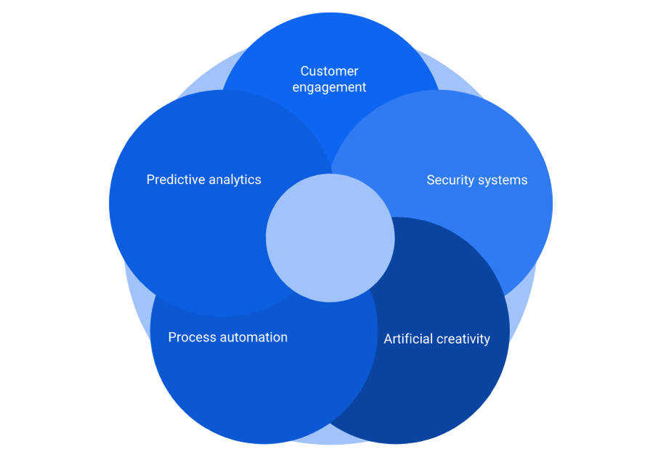
Applications of AI in different business areas

Slide 27
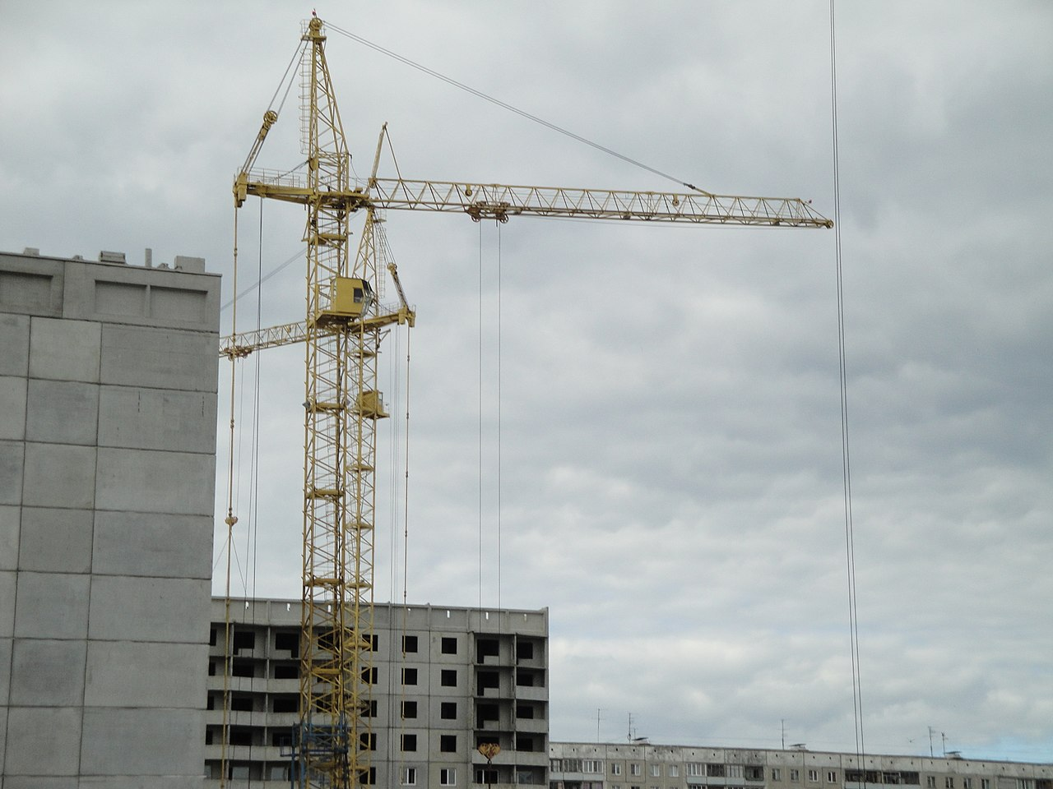
Construction
AI-based applications have been widely being used in the construction sectors.
The AI-based application will make the engineers more productive and capable of delivering high-quality work in the stipulated time frame.

Slide 28

Agriculture
Agriculture is one of the core sectors and we have been modifying the cultivation process to yield more from it.
There are incredible opportunities for AI or machine learning in agriculture.
The technologies like AI & IoT will be very useful in understanding a timely planting, getting predictions, using fertilizers, harvesting and the climate.

Slide 29
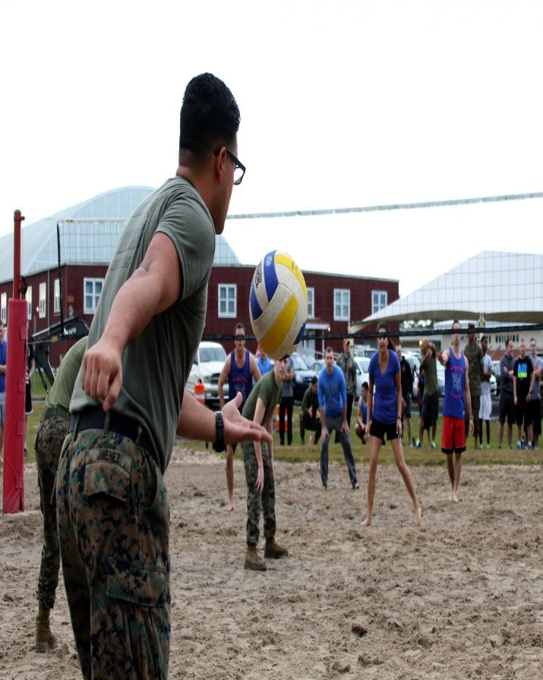
Sports
The implementation of artificial intelligence in the sports industry is a game changer.
There has been a huge demand for AI-based applications in the sports industry as it possesses significant capabilities.
The implementation of the technology is certainly going to solve many major changes in the sports world and it could bring the true competition among the players and athletes.

Slide 30
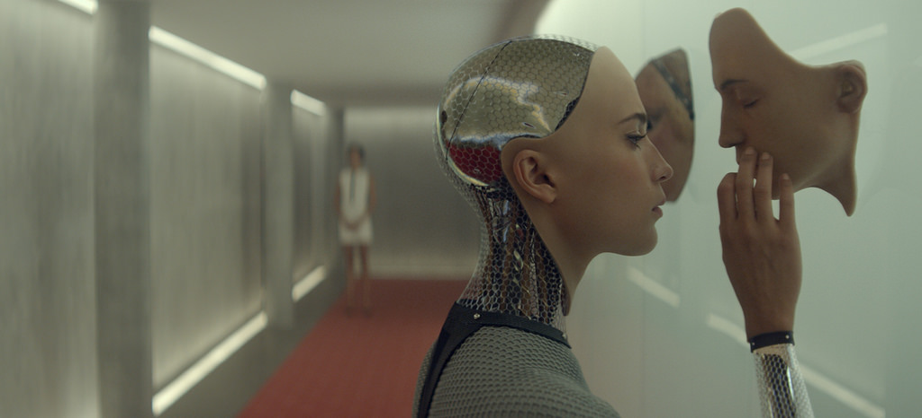
Entertainment
AI or machine learning has brought a big change in the entertainment industry.
AI is everywhere and it is making a big difference in our lives.
When it comes to the entertainment, the algorithms being used by various application make our life much simpler.
AI has really changed the entertainment industry and it will make it more lively in the days to come.

Slide 31
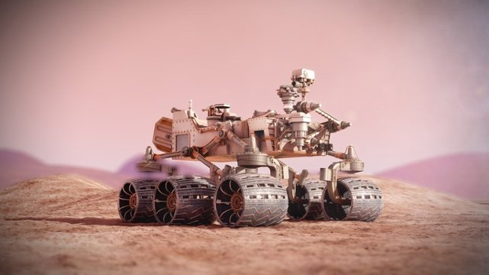
Life On Other Planets
NASA is already using AI to look for life on other planets, which will be the key for “Mars 2020,” the mission where the Red Planet will be explored more thoroughly.
The devices they’ll send, better known as rovers, will be able to explore Mars’ terrain in more detail and reveal the properties of the planet’s elements to determine the possibility of life with more certainty.

Slide 32
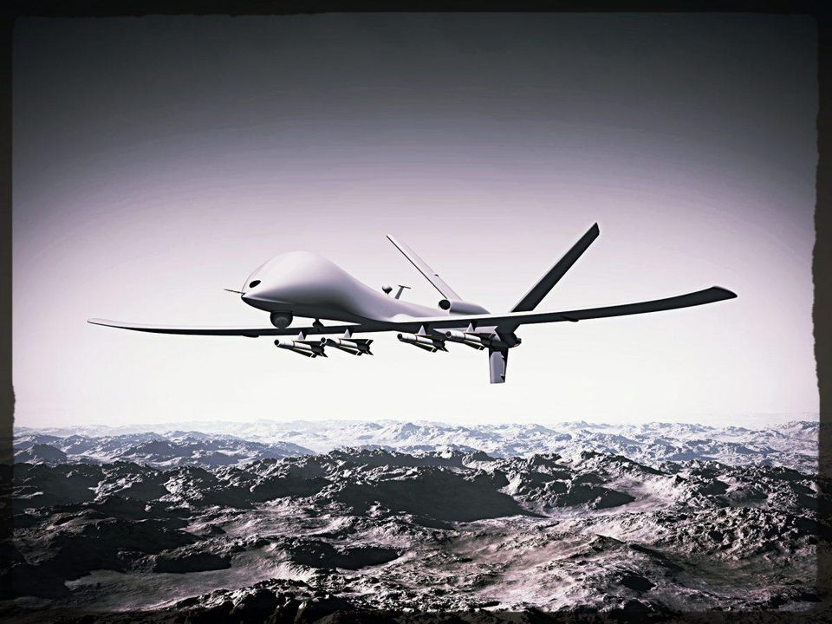
Ways Global Defense Forces Use AI
Military drones for surveillance
Robot soldiers for combat
Intelligent systems for awareness
Secure web-portals for cybersecurity

Slide 33
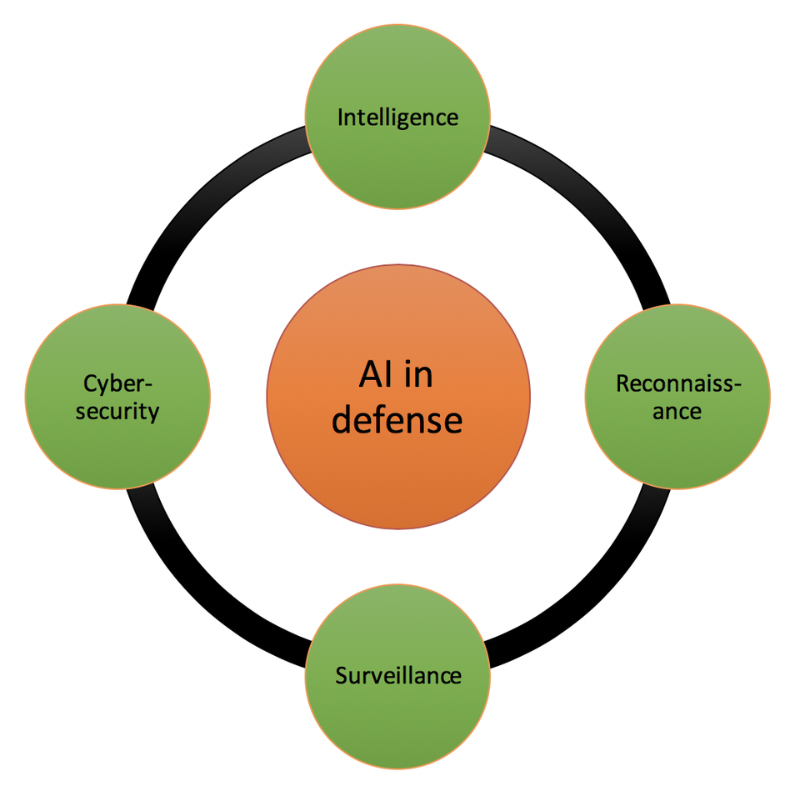

Slide 34
State of the art
Deep Blue defeated the reigning world chess champion Garry Kasparov in 1997
No hands across America (driving autonomously 98% of the time from Pittsburgh to San Diego)
During the 1991 Gulf War, US forces deployed an AI logistics planning and scheduling program that involved up to 50,000 vehicles, cargo, and people
NASA's on-board autonomous planning program controlled the scheduling of operations for a spacecraft
Proverb solves crossword puzzles better than most humans.

Slide 35
Natural Language Processing
Speech technologies
Automatic speech recognition (ASR)
Text-to-speech synthesis (TTS)
Dialog systems
Language Processing Technologies
Machine Translation
Information Extraction
Informtation Retrieval
Text classification, Spam filtering.

Slide 36
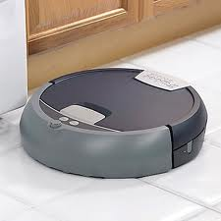
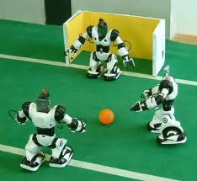
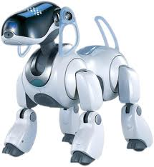
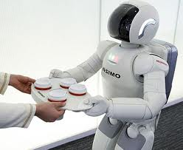
Robotics

Slide 37
Others..
Computer Vision:
Object and Character Recognition
Image Classification
Scenario Reconstruction etc.
Game-Playing
Strategy/FPS games, Deep Blue etc.
Logic-based programs
Proving theorems
Reasoning etc.

Slide 38
Questions

